Slide 1


Stress History of Soils from
Cone Penetration Tests
34th Lição Manuel Rocha
Portuguese Geotechnical Society
Paul W. Mayne, PhD, P.E.
Georgia Institute of Technology
Lisbon, 11 October 2017

Slide 2
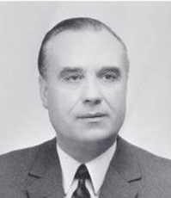
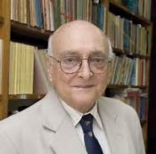
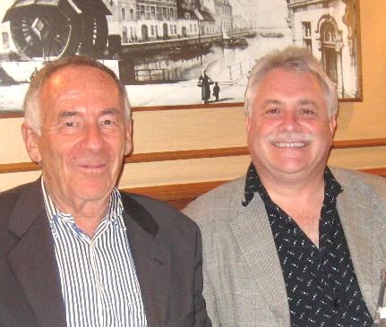

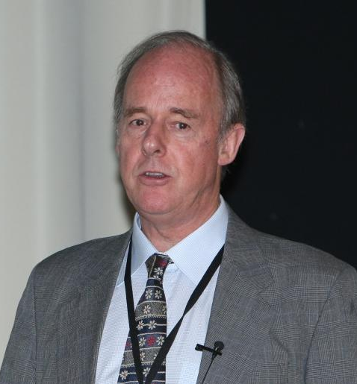
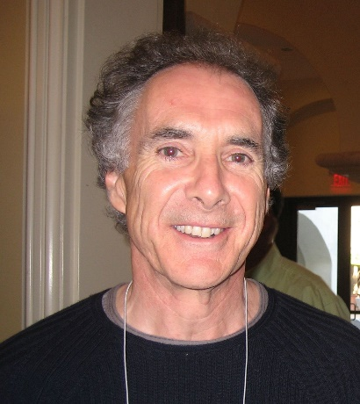

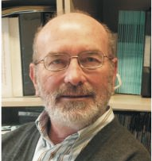
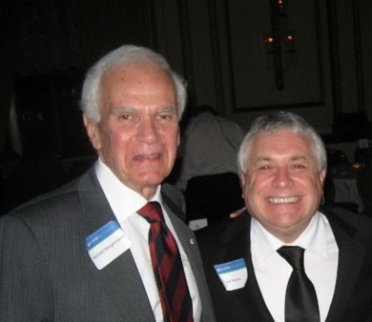
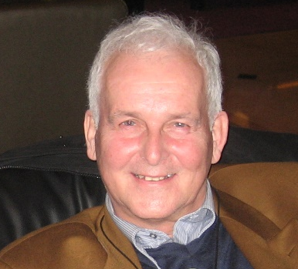
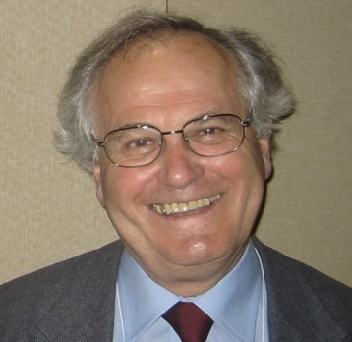
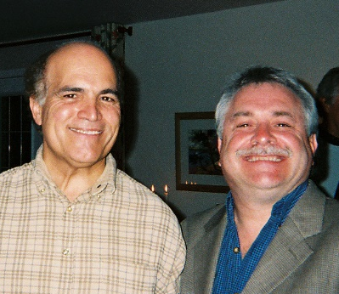
Manuel Rocha (1913-1981)
Victor de Mello (1985)
Mike Jamiolkowski(1997)
Kerry Rowe (2006)
Manuel Rocha
Lectures
Nick Barton (1987)
Mark Randolph (2000)
Manuel Matos Fernandez (2009)
Eduardo Alonso (2013)
Nordie Morgenstern (1989)
William Van Impe (2004)
John Burland (2011)
Antonio Gomes Correira (2016)

Slide 3
Benchmark: Yield Stress from Consolidation Tests
σ_{vo}' = 43 kPa
σ_{p}' = 80 kPa
(most probable)
Casagrande Method (1936)

Slide 4
Effective Yield Stress or Preconsolidation Stress
Maximum past pressure, P_{c}’ = σ_{vmax}’
Preconsolidation Stress, σ_{p}’
Apparent or quasi-preconsolidation
Yield Stress, σ_{vy}’ (Leroueil 2003; Jardine 2003)
NORMALIZED FORMS
Overconsolidation Ratio: OCR = σ_{p}’/ σ_{vo}’
Yield Stress Ratio: YSR = σ_{vy}’/ σ_{vo}’
Virtual OCR: vOCR (Viana da Fonseca 2014)
= ROC
Complement to Lab Testing, Use of CPT and CPTu for Profiling σ_{p}’

Slide 5
Importance of Yield Stress and YSR = σ_{p}’/σ_{vo}’
Separates NC and OC states
Settlement computations
Undrained strength: s_{u}/σ_{vo}’ = ½·sinφ’·YSR^{Λ}
Geostatic stress state: K₀ = (1-sinφ’)·YSR ^{sinφ’}
Porewater pressure behavior, A_{f}
Anchors yield surface for constitutive soil models
Affects elastic modulus: E’ and E_{u}
Small-strain stiffness: G_{max} = F(e)·p’·OCR^{k}
Demarcates: contractive versus dilative behavior
Alternate to state parameter (ψ) for screening:
  flow liquefaction
  cyclic liquefaction
Soil
Mechanics
Soil
Dynamics

Slide 6
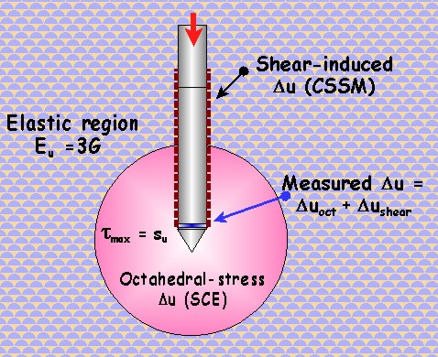
Cavity Expansion-Critical State Model for CPTu-OCR
Clay Properties:
M = 6 sinφ’/(3-sinφ’)
φ’ = effective friction angle
C_{c} = compression index
C_{s} = swelling index
Λ = 1 – C_{s}/C_{c}
I_{R} = G/s_{u} = Rigidity Index
G = shear modulus
s_{u} = undrained shear strength
φ’, C_{c}, C_{s}
Mayne (1991)
Chen & Mayne (1994)
Burns & Mayne (2002)
Mayne (2005, 2007)

Slide 7
SCE-CSSM Analytical Solution
Clays
u₂
q_{t}
Notes:
M = 6 sinφ'/(3-sinφ')
I_{R} = G/s_{u}
Λ = 1 – C_{s}/C_{c} ≈ 0.80
(clays and sands)

Slide 8

THIS U2
f_{s}
u₂
q_{t}

Slide 9
Seismic Piezocone Tests - Hartford, Connecticut
V_{s}
Sand
f_{s}
Brown
Clay
u₂
q_{t}

Slide 10
Brown Clay – Connecticut River, Hartford CT
Triaxial Test Results for Bissell Bridge
Brown
Clay
φ' = 23°
c' = 0

Slide 11
Rigidity Index, I_{R} – Hartford Connecticut
Krage, Broussard, & DeJong (CPT’14):
(consistent
units)
Sand
Brown
Clay
I_{R} = 128
G₀ = ρ_{t} ·V_{s}²

Slide 12


Hartford Connecticut
Sand
Firm
Brown
Clay
σ_{vo}'

Slide 13
SCE-CSSM Theory
For Λ = 1
φ’ = 30º
I_{R} = 100
First-Order Approximations

Slide 14
Soft Clay at Torp, Sweden
(Larsson and Ånhberg 2006: SGI Report R-61)
Soft
Clay
u₂
q_{t}
σ_{vo}'

Slide 15
Bothkennar Soft Clay, UK
(Hight et al. 2003)

Slide 16
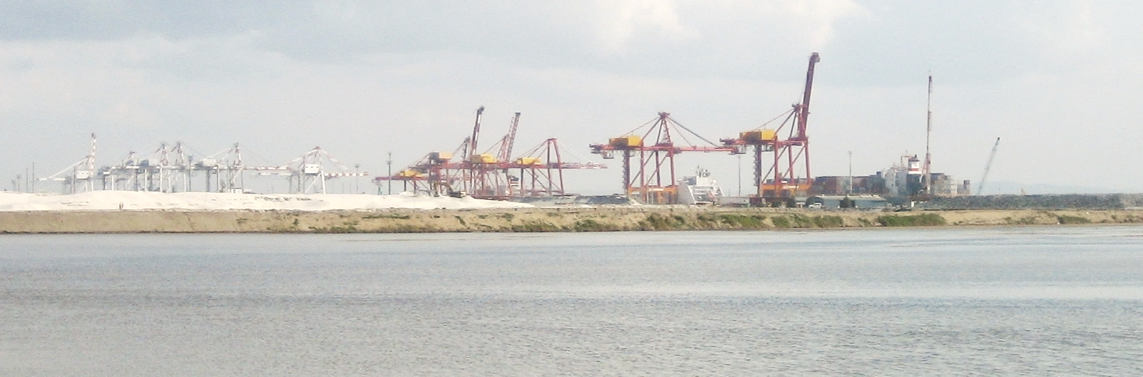
Port of Brisbane Expansion
Hydraulic sand fill over soft clay

Slide 17
CPTu at Port of Brisbane
Hydraulic
Sand Fill
SOFT
CLAY

Slide 18
Port of Brisbane

Slide 19
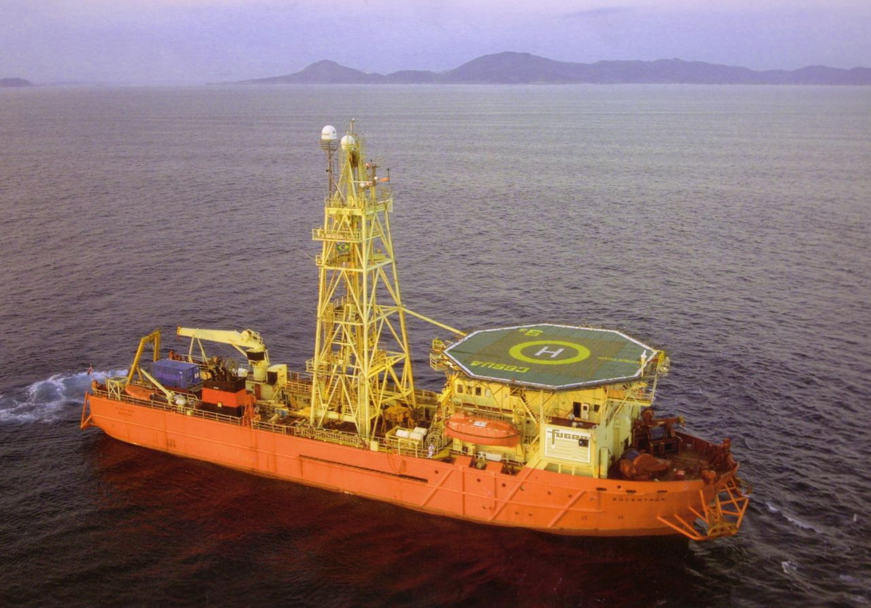
Troll East, North Sea
(Uzielli et al. 2007; Lunne et al. 2007)
The Bucentaur (Courtesy: Fugro Engineers)

Slide 20
Troll East, North Sea (Uzielli et al. 2007)

Slide 21
Troll East, North Sea (Uzielli et al. 2007)

Slide 22
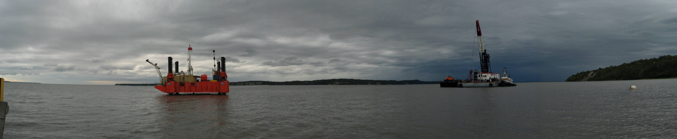
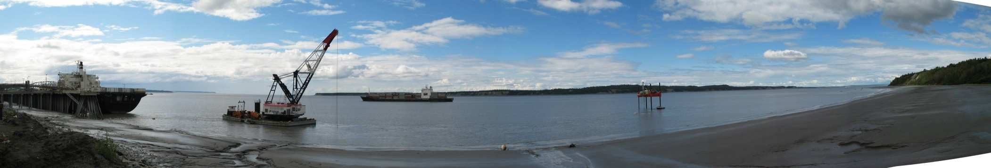
Port of Anchorage, Alaska

Slide 23
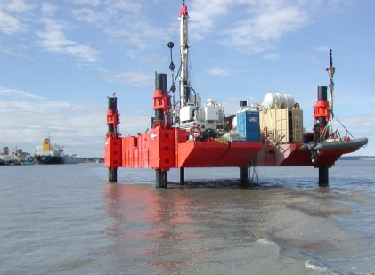
Anchorage Piezocone Sounding
f_{s}
u_{b}
q_{t}

Slide 24
Yield Stress Profile - Port of Anchorage
YSR = 5
YSR = 2

Slide 25

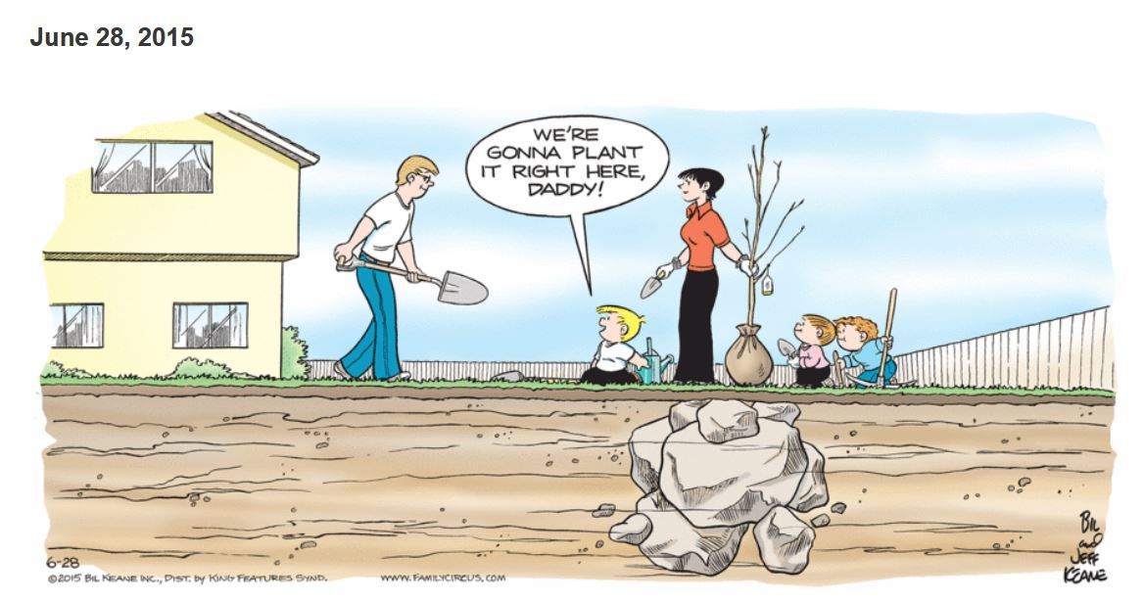
by Jeff Keane

Slide 26
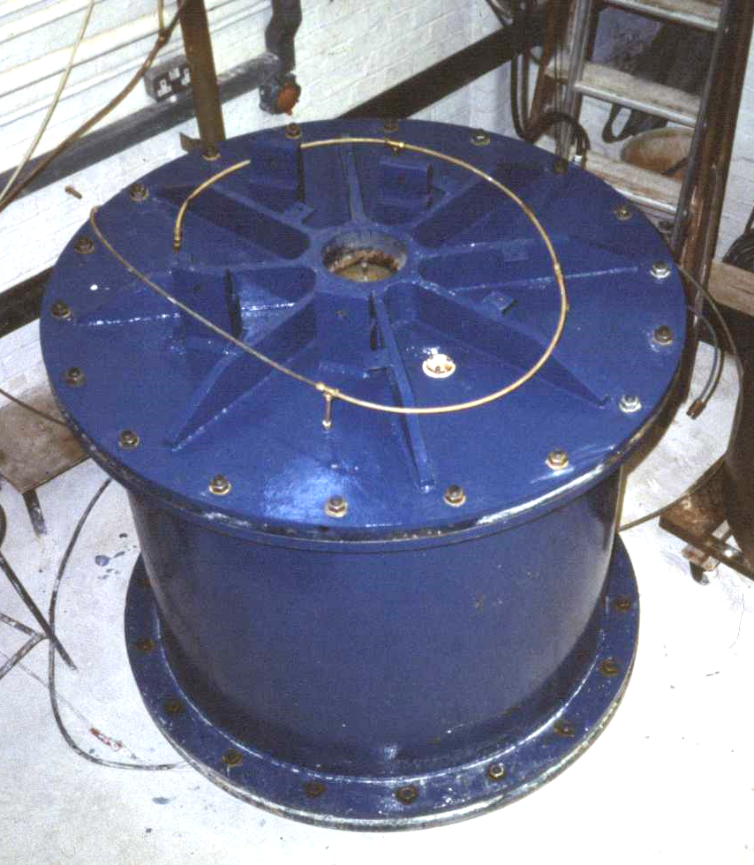
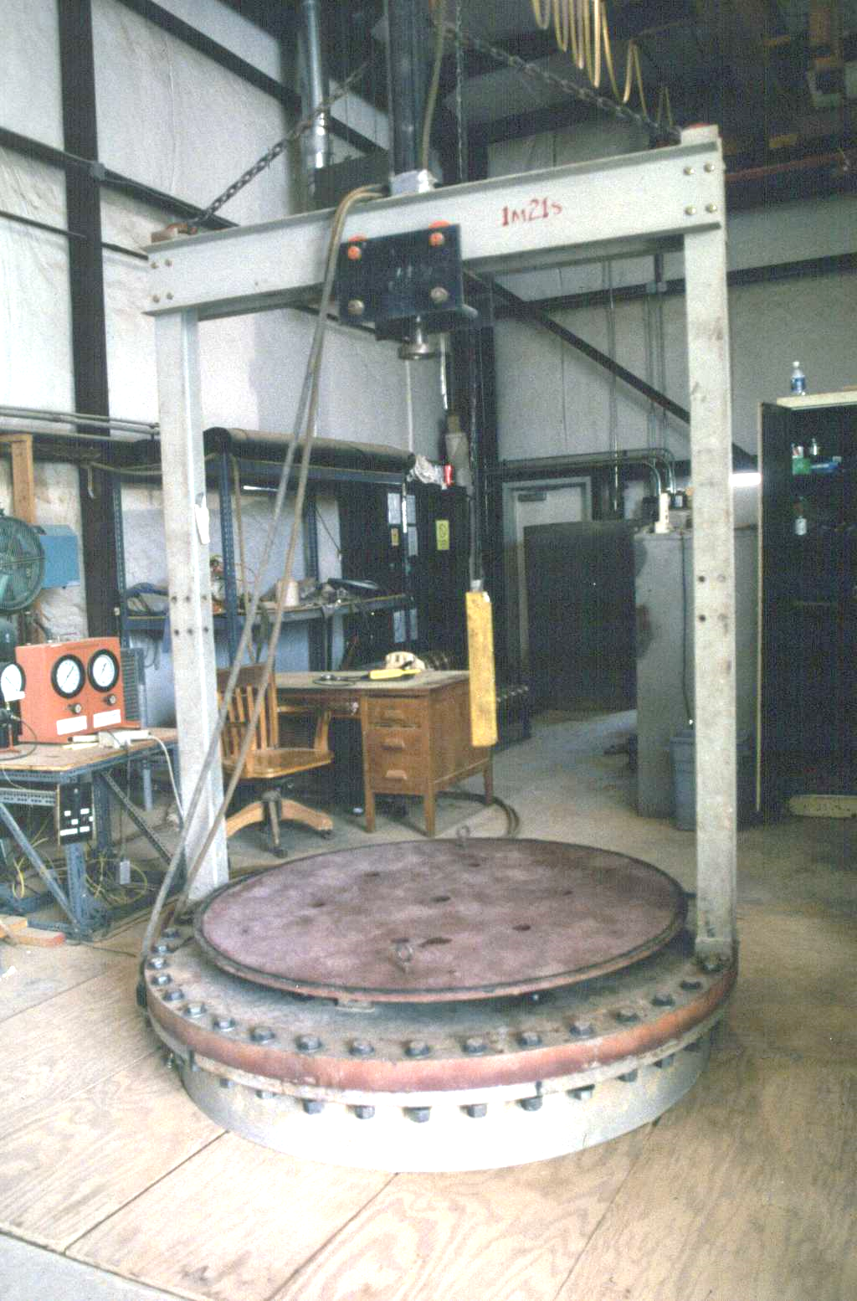
Evaluating Yield Stresses in Sands by CPT
Oxford
University
Flexible Wall Chambers
Essentially large triaxial test
Four boundary conditions:
  BC1 – constant σ_{v}’ and constant σ_{h}’
  BC2 - Δε_{v} = 0 and Δε_{h} = 0
  BC3 – constant σ_{v}’ and Δε_{h} = 0
  BC4 – Δε_{v} = 0 and constant σ_{h}’
Virginia Tech
Calibration Chambers

Slide 27
Calibration Chamber Testing
σ_{vc}'
BC1, BC2, BC3
BC4, and BC5
Mineralogy
Grain Distribution
Angularity
Index Parameters
Age
Origin
Dry or Saturated
Stress History
σ_{hc}'
INVERSE PROBLEM
D_{R}
e_{o}
γ_{T}
Artificial
Sand
Deposit
q_{c}
f_{s}
u₂

Slide 28
CPT Chamber Test Series on Sands
Earlston
Edgar
Erksak
Frankston
Hilton Mines
Hokksund
Hostun
Lanchester
Leighton Buzzard
Light Castle Sand
Oosterschelde
Lone Star
Monterey
Ottawa
Reid-Bedford
South Oakleigh
Ticino
Toyoura
Washed Mortar Sand

Slide 29
CPT Chamber Test Data on Sands
26 Different Sands
n = 626

Slide 30
CPT Methodology for K_{o} and OCR in sands
Regression from CPT Calibration Chamber Database (n = 705 data points; r² = 0.871): K_{o} = 0.192⋅(q_{t}/σ_{atm})^{0.22} (σ_{vo}’/σ_{atm})^{-0.31} YSR ^{0.27}
Relationship between K_{o} and OCR a priori: K_{o} = (1-sinφ’) YSR ^{sin φ’}
Evaluate Effective Stress Friction Angle from Kulhawy & Mayne (1990): φ’ = 17.6°+11⋅log(q_{t1})
where: q_{t1} = (q_{t}/σ_{atm})/(σ_{vo}'/σ_{atm})^{0.5}

Slide 31
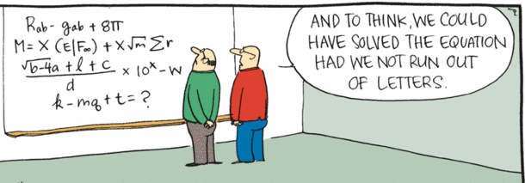
Rhymes with Orange
by Hilary Price "THE LAB"

Slide 32
CPT Methodology in Clean Quartz Sands
Apparent Overconsolidation Ratio, OCR (or Yield Stress Ratio, YSR):
φ’ = effective stress friction angle
q_{t} = cone tip resistance
σ_{vo}’ = effective vertical stress
σ_{atm} = atmospheric pressure (1 bar = 100 kPa)

Slide 33
CPT Methodology in Clean Quartz Sands
Yield Stress Ratio, YSR (or vOCR):
Assume characteristic value: φ’ = 35°
Sands: q_{t} ≈ (q_{t} - σ_{vo})
Simplified:
Preconsolidation Stress:

Slide 34
CPT methodology for all soil types
Reduction of SCE-CSSM model for CPTu in clay:
Simplification of regression equations from CPT calibration chamber tests data on clean sands:
General form:
Exponent m' varies: clay m' = 1.0; sand m' = 0.72

Slide 35
Effective Yield Stress of Soils from CPT
CLAYS
SILTS / MIXED
SANDS
σ_{p}' =0.33(q_{tnet})^{m}

Slide 36
9-Zone Soil Behavioral Type Charts for CPT
(Robertson 1990, 1991)
1. Normalized Tip Resistance: Q = (q_{t} - σ_{vo})/σ_{vo}'
2. Normalized Sleeve Friction (%): F = 100 ⋅ f_{s}/(q_{t} - σ_{vo})
3. Normalized Porewater Pressure: B_{q} = (u₂-u₀)/(q_{t} - σ_{vo})

Slide 37
Soil Behavioral Type by CPT
CPT Material Index (I_{c}) for identification of soil type (Robertson & Wride, 1998):
Modified normalized tip resistance (Robertson 2004):
Exponent n = 0.5 (sands), 0.75 (silts), n = 1.0 (clays)
Iterate to find exponent n (Robertson 2009 CGJ):
sands: I_{c} < 2.05
clays: I_{c} > 2.95

Slide 38
Soil Behavioral
Type (SBTn) Chart
for normalized CPT
(after Robertson 2009)
I_{c} < 2.6: Drained
I_{c} > 2.6: Undrained
Approximate
Algorithm Steps:
a. Find sensitive soils of zone 1 identified when: Q_{tn} < 12 exp(-1.4 F_{r} )
b. Identify: Zone 8 (1.5 < F_{r}< 4.5%) and Zone 9 (F_{r} > 4.5%):
c. Use CPT index I_{c} for Zones 2 through 7

Slide 39
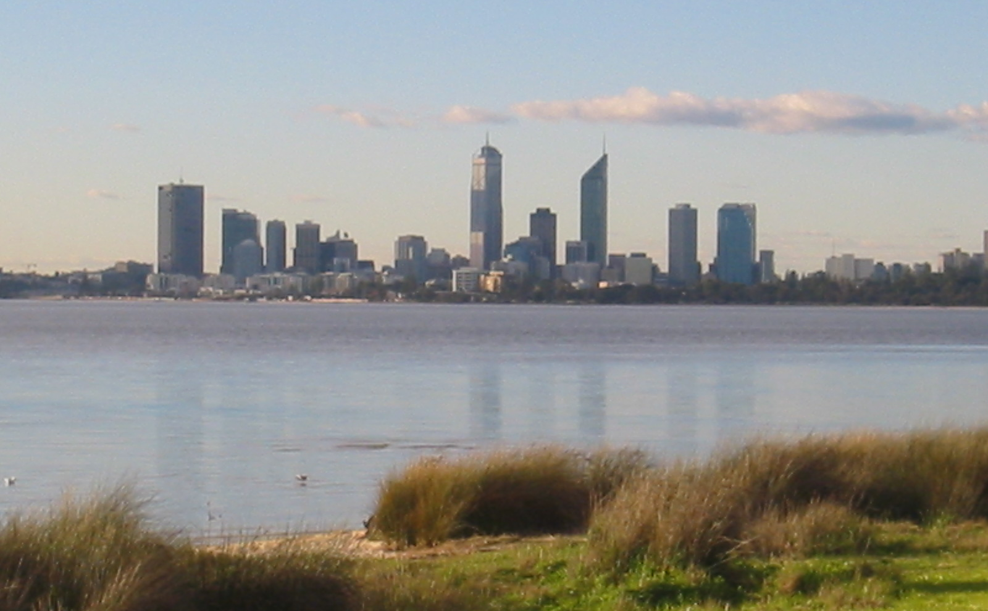
Burswood clay test site, Perth, Australia

Slide 40
Preconsolidation Stress from CPT q_{net} and I_{c}
Burswood Clay, Perth, Australia
σ_{p}' = 0.33(q_{tnet})
Soft
Alluvial
Clay

Slide 41
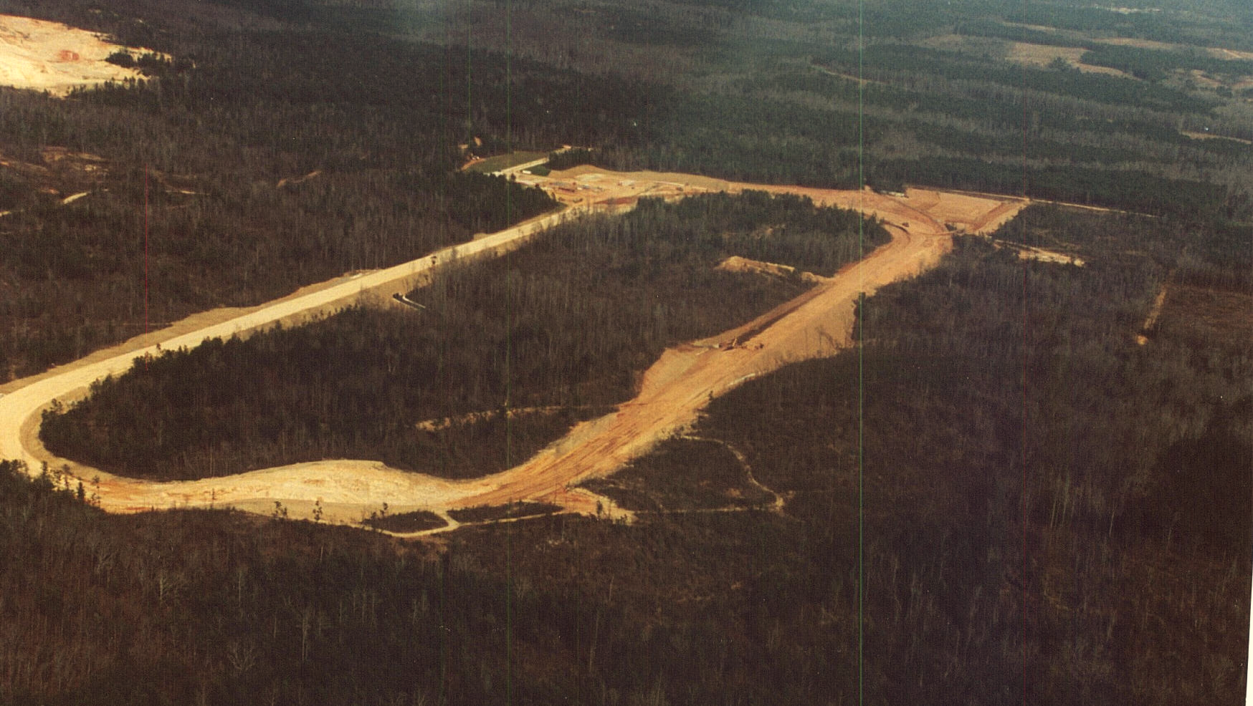
National Geotechnical Experimentation Site
Piedmont Residual fine sandy Silts, Opelika, Alabama

Slide 42
Preconsolidation Stress from CPT q_{net} and I_{c}
National Test Site, Opelika, Alabama:
σ_{p}' = 0.33(q_{tnet})^{0.85}
Residual
Silts and
Sands

Slide 43
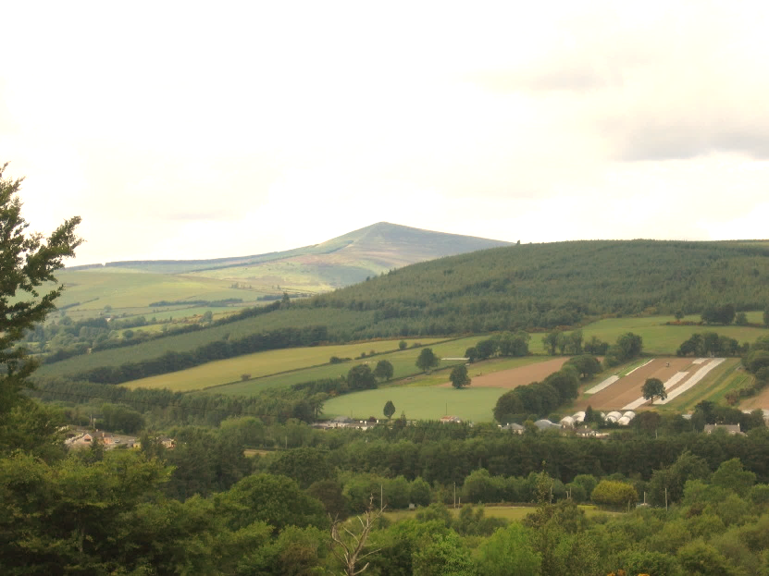
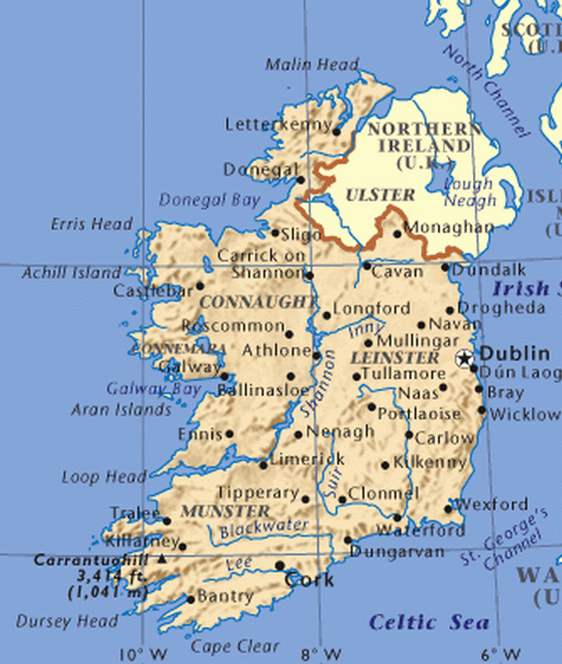

Blessington Sand Site
University of College Dublin (UCD)
Doherty et al. (2012)
Tolooiyan & Gavin (2011)

Slide 44
Dense OC Sand Site, Blessington, Ireland
(Dougherty et al. 2012; Gavin et al. 2014)
Consolidation
Tests
Dense
Fine
Sand

Slide 45
Unified Approach: Yield Stress versus Net Cone Resistance

Slide 46
Yield Stress Exponent m’ Trend with CPT Material Index, I_{c}
Zone No. = 7 6 5 4 3 2
SANDS
Fissured
Clays
Intact Clays
SILTS
Silts
Quartz and
Silica Sands
For I_{c} < 3.5
CLAYS

Slide 47
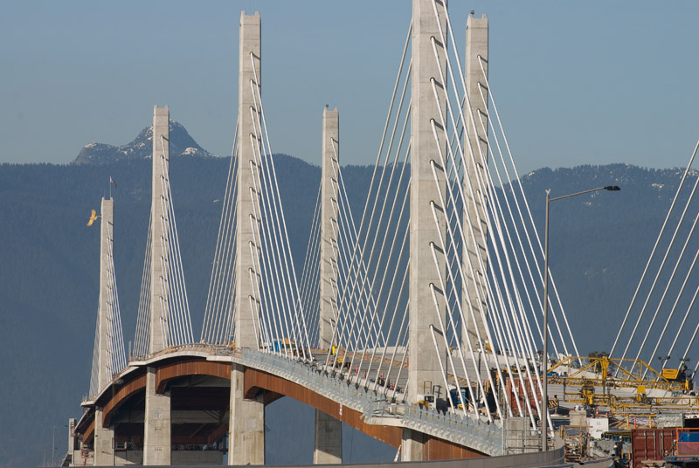
Golden Ears Bridge, British Columbia, Canada
Amini et al. (2008), Niazi et al. (2010)

Slide 48
Golden Ears Bridge, British Columbia (Niazi et al. 2012)
SILT
m’ = 0.85
m’ = 0.72
m’ = 1.0
m’ = 1.0
SAND
Soft and
Loose
Holocene
Deposits
CLAY
Sensitive
CLAY

Slide 49
Golden Ears Bridge, British Columbia (Niazi et al. 2010)
CPT Interpretation of Yield Stress in Layered Soils
σ_{p}’=0.33q_{net}^{m’}
SILT
m’ = 0.85
m’ = 0.72
m’ = 1.0
m’ = 1.0
SAND
CLAY
σ_{vo}’
Silt Mix
Sand Mix
Sensitive
CLAY
Gravelly Sand
Sand
Organic
Clay

Slide 50
Golden Ears Bridge, British Columbia (Niazi et al. 2010)
CPT Interpretation of Yield Stress in Layered Soils
SILT
SAND
CLAY
Silt Mix
Sand Mix
Sensitive
CLAY
Gravelly Sand
Sand
Organic
Clay

Slide 51


CPT σ_{p}’ Method Applicable to “Hourglass Sands” and “Vanilla” Clays
Quartz-Silica Sands Inorganic Clays
Uncemented of low sensitivity

Slide 52
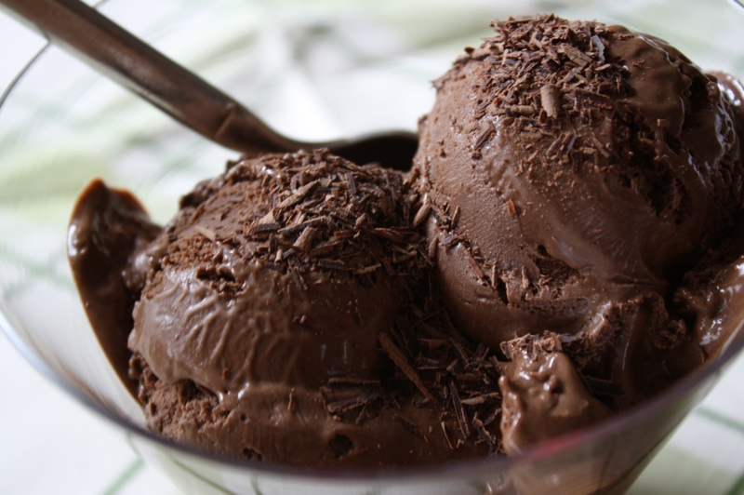
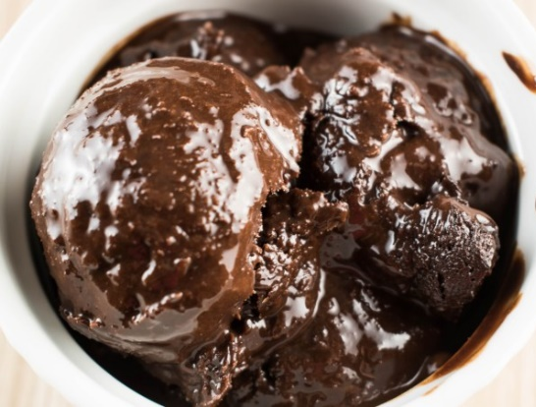
What about “Chocolate” Clays ?
Milk Chocolate Clay
Dark
Chocolate Gelato Clay with
Hazelnuts

Slide 53
Profiling Yield Stress in Clays by CPT
0.43
0.33
0.16

Slide 54
Piezocone CPTU-L2 in Mexico City Clay
(Cruz and Mayne, GeoShanghai 2006)

Slide 55
Stress History from CPTu in Mexico City Clay
(Cruz and Mayne, GeoShanghai 2006)
Simplified Solution DOES NOT WORK
WARNING
SIGN

Slide 56
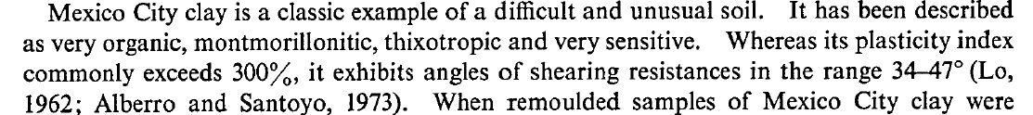
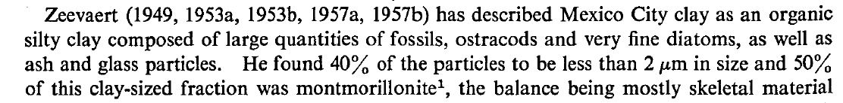
Mexico City Clay
Mesri (1975, Geotechnique):
Zeevaert (1957):

Slide 57
Piezocone CPTu-L2 in Mexico City Clay
(Robertson 1991, 2009)

Slide 58
Unified Approach: Yield Stress versus Net Cone Resistance

Slide 59
Stress History from CPTu in Mexico City Clay
(Cruz and Mayne, GeoShanghai 2006)
Organic Clays: σ_{p}’ (kPa) = 0.33 (q_{t} – σ_{vo})^{0.90}

Slide 60
Sarapui II soft organic clay, Brazil (Jannuzzi et al. 2016)
Yield Stress: σ_{p}’ = 0.33 q_{net}^{0.88}
Consols
σ_{p}’ = 0.33 q_{net}^{0.88}

Slide 61


"You need a new recipe. This mud tastes terrible"

Slide 62
Evaluate Flow Liquefaction Potential by CPT
1. State Parameter for Sands from CPT (Been et al 1987, Jefferies & Been 2005)
2. Equivalent normalized cone resistance for clean sands, Q_{tn-cs} = K_{c}·Q_{tn} (Robertson 2010)
3. CPT evaluation of yield stress ratio at critical state line: YSR_{CSL} ≈ 3
Rather Involved and Complex Relationships
Correction for Fines Content adds Uncertainty
Simple Procedure

Slide 63
VCL
Define: State Parameter
ψ = e₀ - e_{CSL}
CSL
Virgin compression line
Critical state line
e₀
(e_{0,} P₀')
Contractive:
ψ = e₀ - e_{CSL} > 0
e_{CSL}
Void Ratio, e
Dilative:
ψ = e₀ - e_{CSL} < 0
e₀
(e_{0,} P₀')
Logarithm Effective Stress, σ_{v}'

Slide 64
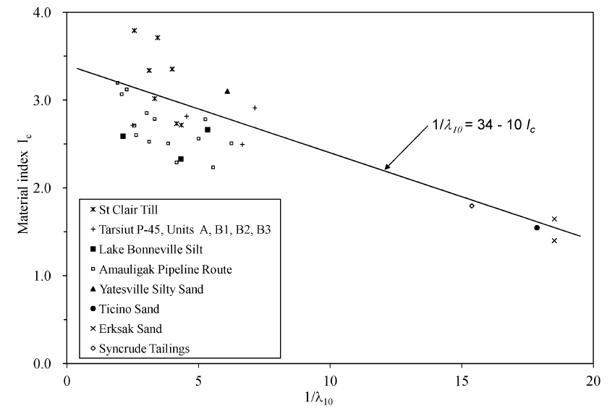
State Parameter for Sands from CPT
(Been et al 1987, Jefferies & Been 2005, 2016)
1/λ₁₀ = 34 - 10·I_{c-JB}
CPT Material Index, I_{c-JB}
λ₁₀ = slope of e-log₁₀(p’)
1/λ₁₀

Slide 65
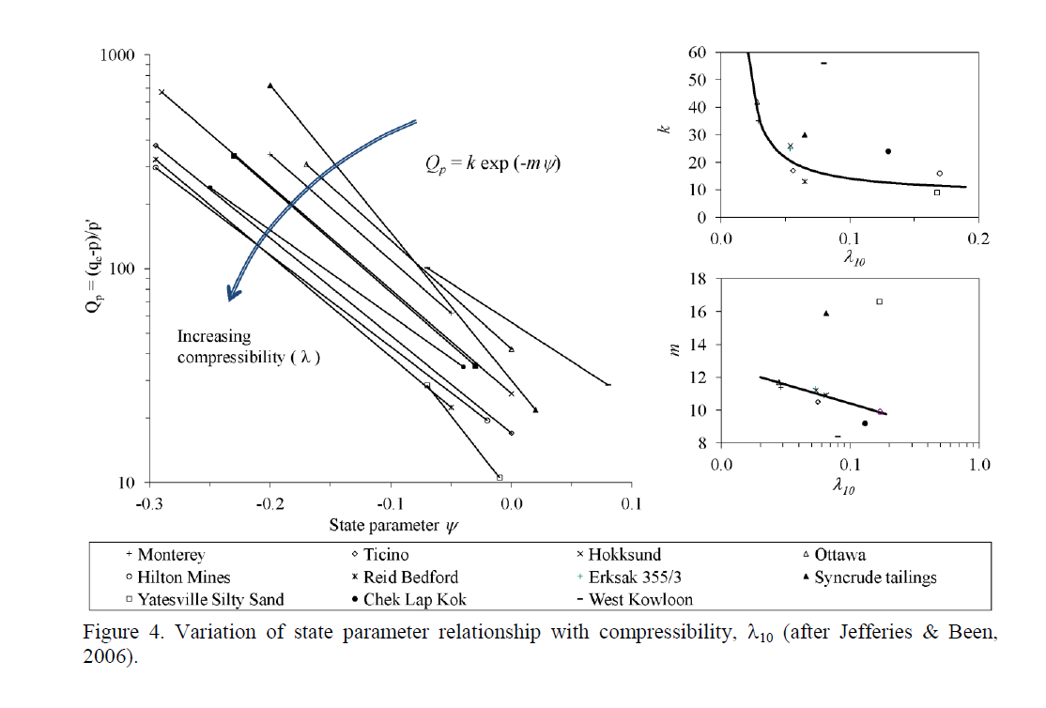
State Parameter for Sands from CPT
(Been et al 1987, Jefferies & Been 2005, 2016)
Q_{p} = (q_{t} – p)/p’
State Parameter, ψ

Slide 66
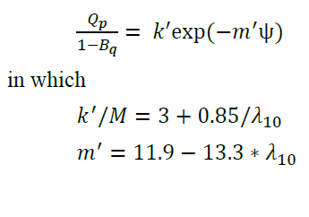
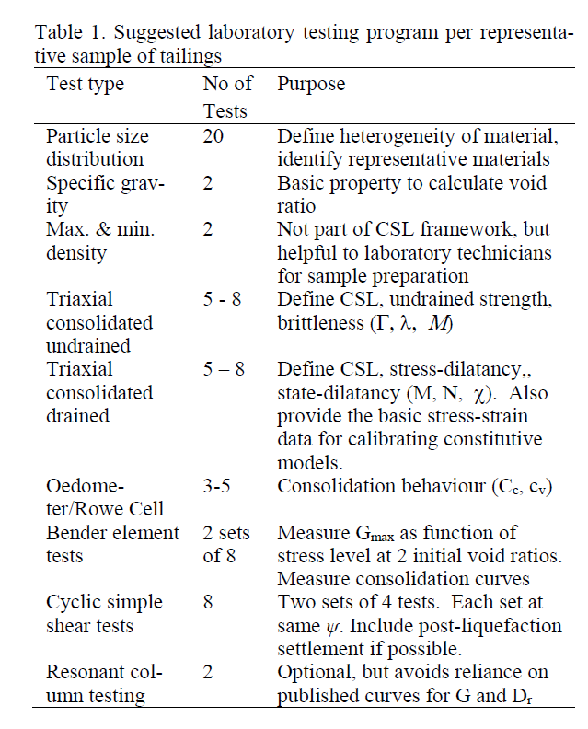
Modified State Parameter for Tailings from CPT
(Been et al 2012, Jefferies & Been 2016)
CPT Analyses
Lab Testing
1/λ₁₀ = 34 - 10·I_{c-JB}
M = 6·sinφ’/(3-sinφ’)

Slide 67
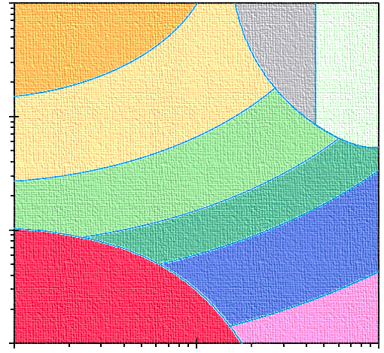
Robertson (2012) Procedure for Flow Liquefaction
Stiff
clayey
Sand
(Zone 8)
Gravelly SANDS
(Zone 7)
Very
Stiff
clays
and
silts
(Zone 9)
SANDS
(Zone 6)
Sandy Mix
(Zone 5)
Silty Mix
(Zone 4)
CLAYS
(Zone 3)
Sensitive Soils
(Zone 1)
Organic
(Zone 2)

Slide 68
Adjustment for Sand Fines Content
Equivalent Normalized Cone Resistance: Q_{tn-cs} = K_{c} · Q_{tn}
For clean sands
For I_{c} ≤ 1.64: K_{c} = 1.0
For I_{c} > 1.64: K_{c} = - 0.403 I_{c}⁴ + 5.581 I_{c}³ - 21.63 I_{c}² + 33.75 I_{c} - 17.88

Slide 69
CPT SBT Liquefaction Susceptibility
(Robertson 2010)
Regions
A₁ = Sands: Cyclic Liquefaction Possible
A₂ = Sandy to Silty Soils: Cyclic and Flow Liquefaction Possible
B = Clays and Silts: Cyclic softening Possible
C = Sensitive Clays: Flow Liquefaction and Cyclic Softening Possible

Slide 70

Flow Liquefaction Susceptibility
(Robertson 2010, 2016)
Contractive Soils are susceptible to flow liquefaction
Theoretically contractive when ψ > 0
Practical threshold when ψ > -0.05
Estimate ψ = 0.485 - 0.314·log(Q_{tn-cs})
Contractive when Q_{tn-cs} < 70
<

Slide 71
Gold Tailings, Western USA (Been et al. 2012)
Loose
to Soft
Tailings

Slide 72
Gold Tailings, Western USA (Been et al. 2012)
Robertson
Q_{tn-cs} = 70
Jefferies
& Been
ψ = -0.05
Contractive Dilative

Slide 73
Simplified Critical-State Soil Mechanics
VCL
s_{u} = (sinφ'/2)∙YSR^{Λ} ∙ σ_{vo}'
Δu = (1 - ½ cos φ' YSR^{Λ} )∙ σ_{vo}'
where Λ = 1 - C_{s}/C_{c}
CSL
C_{c}
−Δu
+Δu
Normally Consolidated (NC)
e₀
Void Ratio, e
C_{s}
Overconsolidated (OC)
Yield Stress Ratio
= YSR = σ_{y}'/σ_{vo}'
Effective
Overburden Stress
Yield Stress
σ_{vo}'
σ_{y}'
Logarithm Effective Stress, σ_{v}'

Slide 74
Simplified Critical State Soil Mechanics
Virgin Compression
Line, VCL
s_{u} = (sinφ'/2)∙YSR^{Λ} ∙ σ_{vo}'
Δu = (1 - ½ cos φ' YSR^{Λ} )∙ σ_{vo}'
Critical State
Line, CSL
C_{c}
ψ = - C_{c} ∙ log[ ½∙cos φ'∙YSR^{Λ} ]
Λ = 1 - C_{s}/C_{c} ≈ 0.8 (sands & clays)
e_{CSL}
YSR_{CSL} = (2/cos φ')^{1/Λ}
State Parameter
= ψ = e₀ - e_{CSL}
drained
e₀
undrained
Void Ratio, e
Yield Stress Ratio
= YSR = σ_{p}'/σ_{vo}'
C_{s}
Normally Consolidated (NC)
Overconsolidated (OC)
Dilative
Behavior
Contractive
Behavior
Effective
Overburden
Stress
σ_{vo}'
Yield Stress
σ_{p}'
Logarithm Effective Stress, σ_{v}'

Slide 75
CPT Screening for Flow Liquefaction
Soils are contractive when:
1. State Parameter: ψ = e₀ - e_{CSL} > 0
(practical threshold: ψ > - 0.05 )
2. Yield Stress Ratio: YSR_{CSL} < (2/cos φ')^{1/Λ}
(or approximate threshold: YSR_{CSL} < 3)
(Robertson 2016: OCR < 4)

Slide 76
Gold Tailings, Western USA (Been et al. 2012)
σ_{p}‘= 0.33q_{net}^{m’}
Sandy Mixs
Sands
σ_{vo}'
Silts
Clay

Slide 77
Gold Tailings, Western USA (Been et al. 2012)
YSR at
critical state
= (2/cosφ')^{1/Λ}
Contractive Dilative
Contractive Dilative

Slide 78
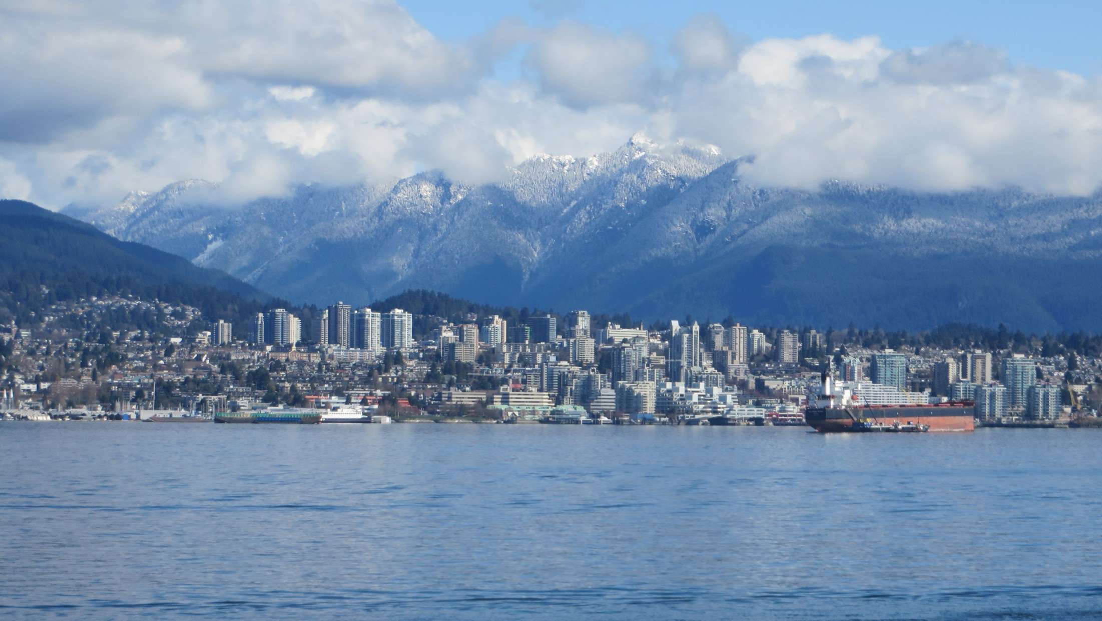
Flow Liquefaction Case Study
Sands Head, Fraser River Delta, BC (Christian et al., 1997 CGJ)

Slide 79
Sands Head, Fraser River Delta, BC
(Christian et al. 1997)

Slide 80
Sands Head, Fraser River Delta, BC
Q_{tn-cs} = 70
YSR at
critical state
Contractive Dilative

Slide 81
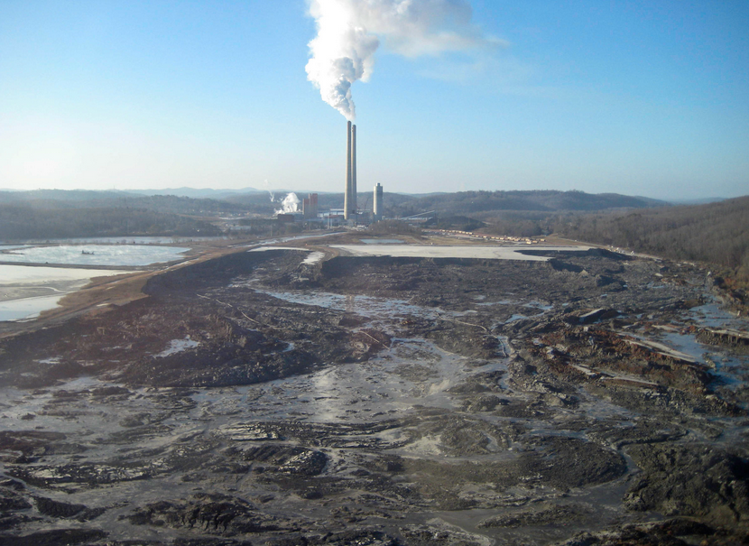
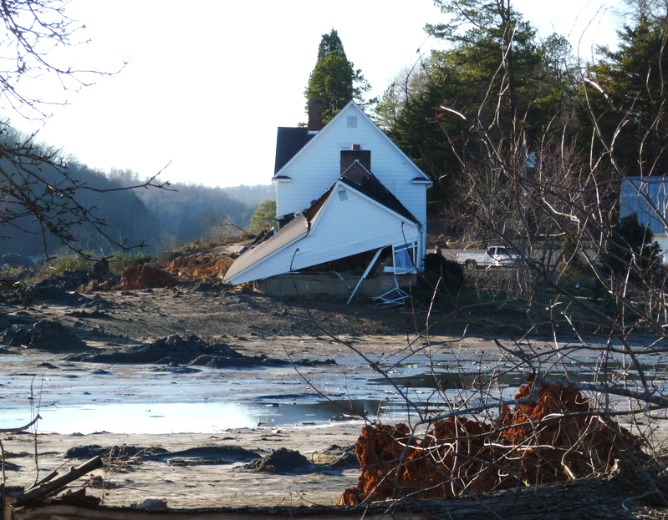
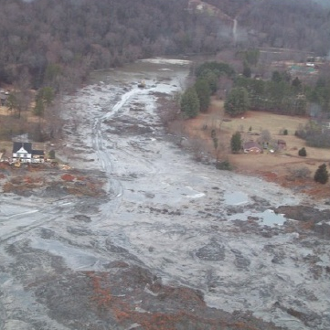
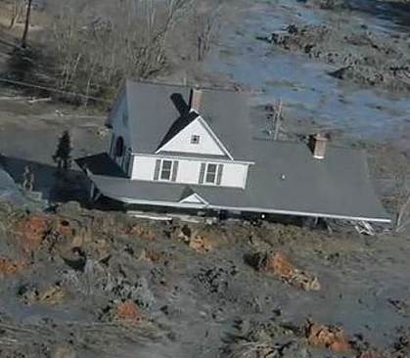
Kingston Flyash Failure, Tennessee (22 Dec 2008)
Flow Liquefaction Case Study
TVA stockpile dam fails into Emory River

Slide 82
Kingston Flyash Failure, Tennessee (Robertson 2010)
Flow Liquefaction Case Study
f_{s}
u₂
q_{t}

Slide 83
Flow Liquefaction Case Study
Kingston Flyash Failure, Tennessee (Robertson 2010)
YSR_{CSL}
Q_{tn-cs} = 70
Weak Layer
Weak Layer
Sandy Mix
Sand
Silt
Clay
Contractive Dilative

Slide 84

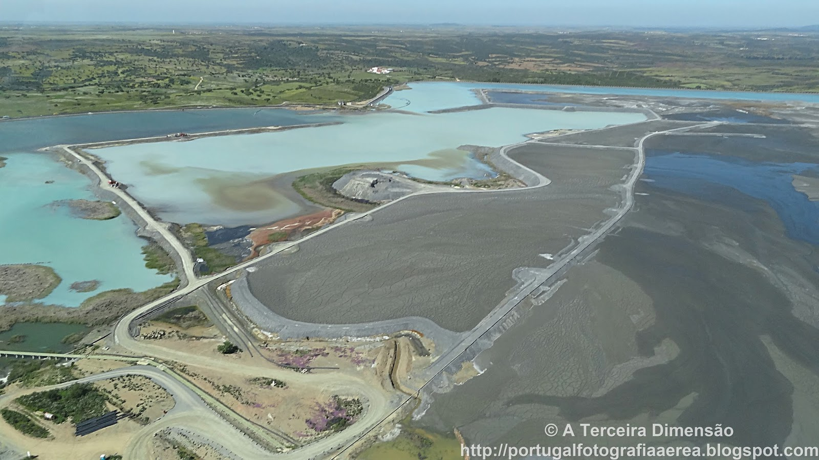
Neves Corvo Tailings, Portugal
Liquefaction potential of paste fill at Neves Corvo mine, Portugal
K. Been, E. T. Brown & N. Hepworth published online 05 Sept 2013

Slide 85
CPT-001 Neves Corvo Tailings, Portugal
Flow Liquefaction Screening Evaluation (Been et al 2002)
Been
et al
(2002)
Tailings
YSR < 1
Underconsolidated
Gravelly Sand
Sand
Sand Mix
Organic
Clay
Silt Mix
Dilative Contractive

Slide 86
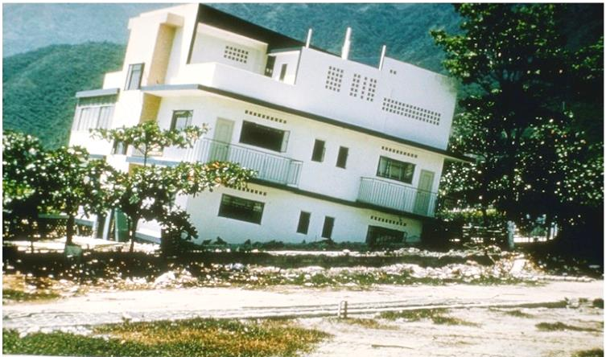
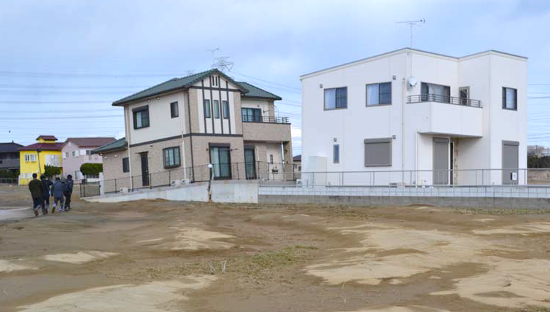
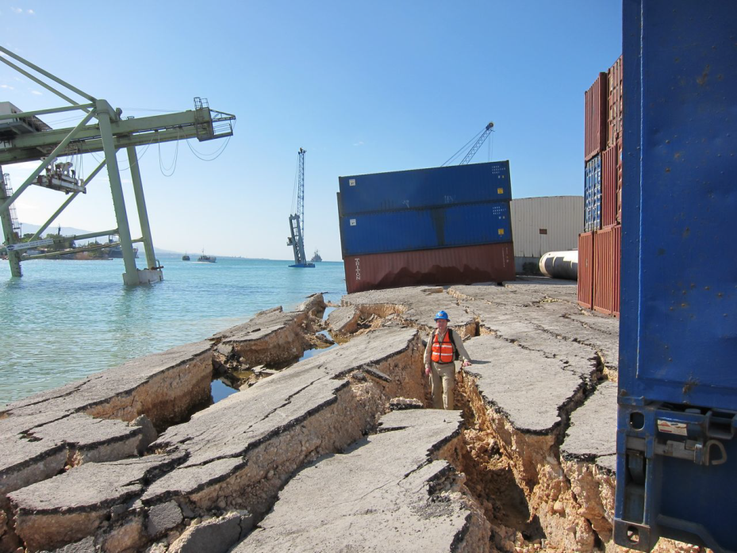
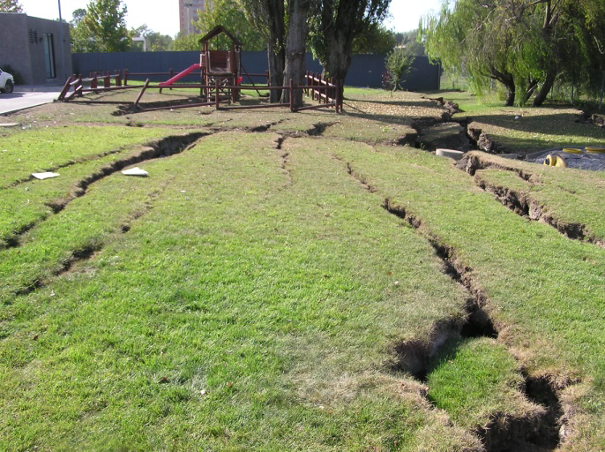
CPT Evaluation of Cyclic Soil Liquefaction
Haiti 2010 (courtesy Univ. Idaho)
Tohoku Japan 2011
Haiti (2010) courtesy Glenn Rix
Chile 2010 (courtesy J. Bray & J.D. Frost)

Slide 87
Cyclic Liquefaction Evaluation by CPT
(Youd, et al. 2001; Boulanger & Idriss 2014)
Simplified Approach uses Cyclic Stress Ratio (CSR):
τ = average cyclic shear stresses
a_{max}/g = PGA = peak (horiz.) ground acceleration
σ_{vo} = total vertical (overburden) stress
σ_{vo}' = effective vertical stress
r_{d} = stress reduction coefficient
MSF = magnitude scaling factor convert to M_{w} = 7.5

Slide 88
Simplified Cyclic Stress-Based Procedures
Level of Ground Shaking:
Soil resistance based on in-situ field tests:
  SPT = standard penetration
  CPT = cone penetration
  V_{s} = shear wave velocity
  DMT = flat dilatometer
Compare CSR with Cyclic Resistance Ratio (CRR) for likelihood for liquefaction.
CRR
Liquefaction
Likely
Liquefaction
Not Likely

Slide 89
Cyclic Liquefaction Evaluation by CPT
(Robertson & Wride 1998; Youd et al. 2001)
Evaluate the Cyclic Resistance Ratio (CRR) of clean sands from CPT stress-normalized cone resistance (Q_{tn})
For range: 50 ≤ Q_{tn} ≤ 160
For Q_{tn} < 50

Slide 90
Evaluate Soil Liquefaction by CPT
for clean sands (Robertson & Wride 1998)
NCEER (2001)

Slide 91
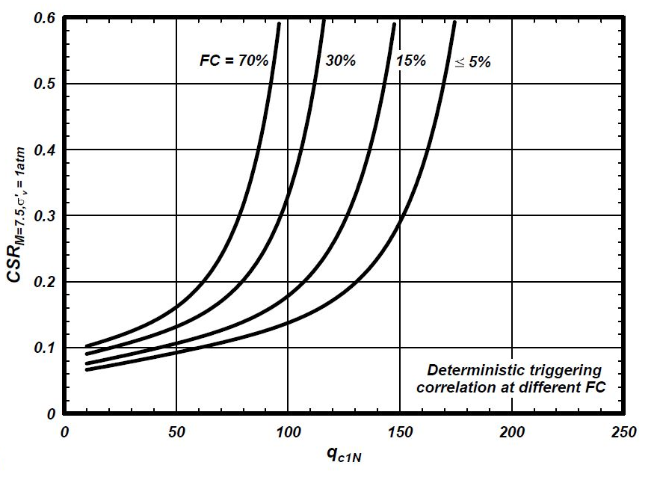
Cyclic Liquefaction Evaluation by CPT
Effect of Fines Content (FC) on CRR (Boulanger and Idriss 2014)

Slide 92
Liquefaction Evaluation of Sands by CPT
NCEER/NSF
(Youd, et al.
2001)
Robertson & Wride (1998 CGJ);
Robertson
(2010, CGJ)
Exponent n ≈ 0.5 ± 0.2
Q_{tn} = (q_{t} - σ_{vo})/(σ_{vo}')^{n} (in units of bars or atmospheres)

Slide 93
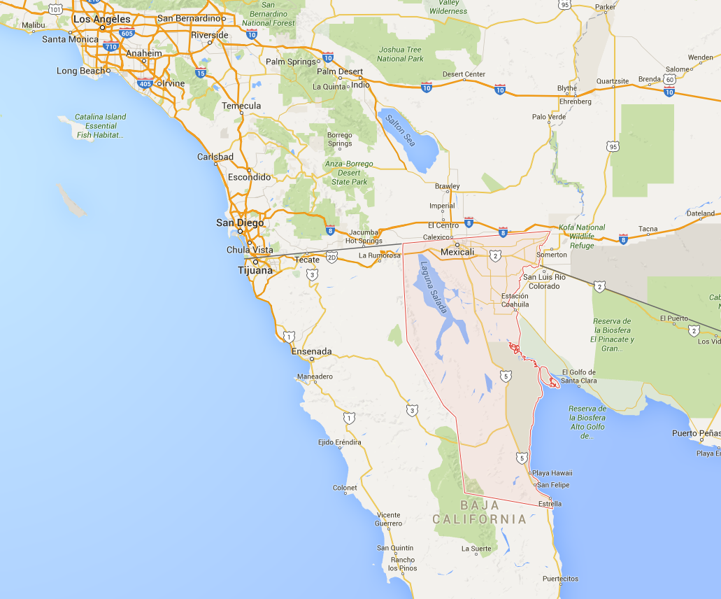
San Felipito Bridges
Baja, Mexico
PGA = 0.27 g
Liquefaction Case Study (Turner et al. 2016)
San Felipito Bridges, Baja, Mexico
Epicenter
APRIL 4, 2010
M 7.2
EL MAYOR-CUCAPAH
EARTHQUAKE

Slide 94
San Felipito Bridges, Mexico (Turner et al. 2014)
Highway Bridge on
On Drilled Shafts - Okay
Railroad Bridge on
Driven Pilings – Lost Segment

Slide 95
San Felipito Bridge, Mexico
Sands
with
silty sandy
layers

Slide 96
San Felipito Bridge, Mexico
Gravelly Sand
Sand Mix
Organic
Sand
Silt Mix
Clay

Slide 97
San Felipito 2010 EQ (Turner et al 2014, 2016) M = 7.2; PGA = 0.27
Factor of Safety
FS = CRR_{7.5}/CSR_{7.5}

Slide 98
San Felipito Liquefaction
Sandy Layers
Identified as
Contractive
FS = CRR_{7.5}/CSR_{7.5}

Slide 99
Marina District, San Francisco CA (Loma Prieta EQ 1989) (Zhang, et al. CGJ 2002): M=7.0 and PGA = 0.20
YSR
Critical
Layer 1
Critical
Layer 2
CSL
Threshold
Gravelly Sand
Clay
Sand Mix
Sand
Silt Mix
Organic

Slide 100
Moss Landing, CA: M_{w}=7.0; PGA = 0.25 g
Kulasingam, R., Boulanger, R. W., and Idriss, I. M. (1999).
Proceedings, 7th US-Japan Workshop on Earthquake Resistant Design of Lifeline Facilities and Countermeasures Against Liquefaction, Technical Report MCEER-99-0019, MCEER, SUNY, Buffalo, 35-54.
Critical
Layer 1
YSR
Critical Layer 2
Critical Layer 3
Gravelly Sand
Sand Mix
Clay
Organic
Silt Mix
Sand
CSL
Threshold
FS = CRR_{7.5}/CSR_{7.5}

Slide 101
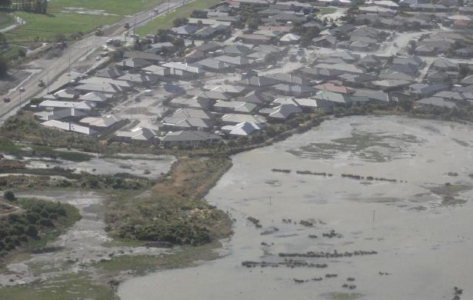
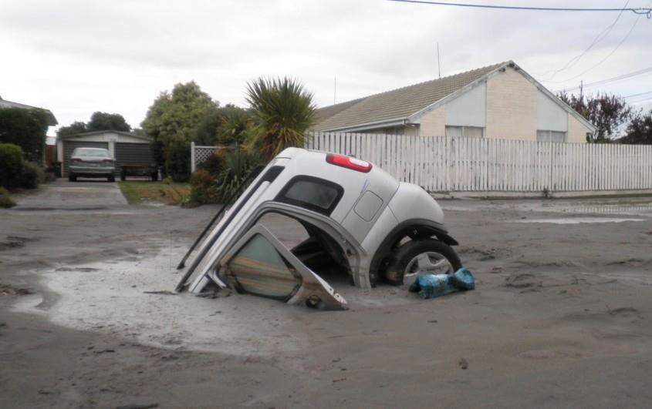
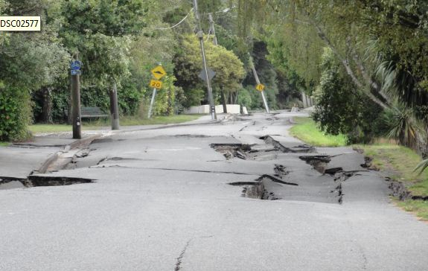
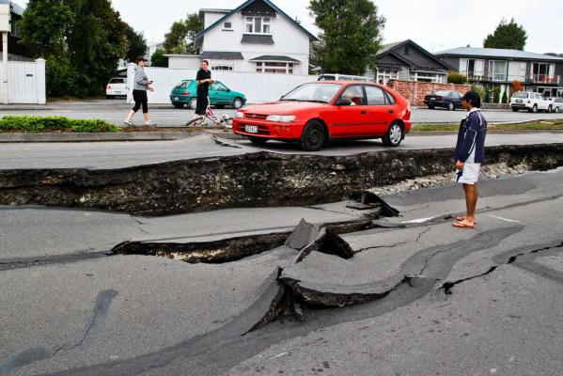
Cyclic Liquefaction – 4 EQs in NZ (2010-2011)
Christchurch NZ 2011
Christchurch NZ 2011
Christchurch (Green 2010)
Christchurch (Green 2010)

Slide 102
Christchurch Site 11, North Kaiapoi, New Zealand
(CPT-KAN-26 from Green et al. 2014, Earthquake Spectra)
Critical
Layer 2
Critical
Layer 1

Slide 103
Site 19, Brighton, Christchurch 2011 Earthquake
Liquefaction Case (Green et al 2014)
M = 6.2 and PGA = 0.35
Critical
Layer 2
Liquefied
Sand
Critical
Layer 1
Gravelly Sand
Sand Mix
Silt Mix
Organic
Sand
Clay

Slide 104


Seismic Map of USA: New Madrid Seismic Zone
1811-1812: M_{w} = 7.1, 8.1, and 7.6
Occurred about 56 years
After the 1755 earthquake
In Portugal
Scale:
PGA = a_{max} (m/s²)
www.usgs.gov

Slide 105
Walker Paleoliquefaction Site, Marked Tree New Madrid Seismic Zone
(Liao & Mayne 2010; Tuttle 1999): M_{w} = 7.6 and PGA = 0.19 g

Slide 106
Marked Tree, Arkansas (NMSZ): GWT 2 to 5 m
Overconsolidation Ratio CRR and CSR
Likely
Marginal
Likely
Likely

Slide 107
Lesson: Yield stress of soils from CPT
For intact inorganic clays:
σ_{p}’ = 0.33·(q_{t} – σ_{vo})
σ_{p}’ = 0.53·(u₂ – u₀)
σ_{p}’ = 0.60·(q_{t} – u₂)
For uncemented quartz-silica sands
σ_{p}’ (kPa) = 0.33·(q_{t} – σ_{vo})^{0.72}
“Vanilla” Clay
MATCH
“Hourglass” Sand

Slide 108
Lesson: Yield stress of soils from CPT
Yield Stress (kPa): σ_{p}’ = α_{q}·(q_{t} – σ_{vo})^{m’}
α_{q} = fctn( φ’, I_{R} = G/s_{u}, mineralogy)
For φ’ = 30°, I_{R} = 100, then α_{q} = 0.33
σ_{p}’ (kPa) = 0.33·(q_{t} – σ_{vo})^{m’}
Exponent m’ = 1.1 Fissured Clays
1.0 Intact inorganic clays
0.9 Organic clays
0.85 Silts
0.80 Sandy Silts
0.75 Silty Sands
0.72 Clean quartz-silica sands
Brazilian
Clays
α_{q} = 0.15
Brazilian
Clays
For quartz-silica sands and inorganic clays of low-medium sensitivity, m’ is related to CPT Material Index, I_{c}

Slide 109
Yield Stress Exponent m’ Trend with CPT Material Index, I_{c}
Zone No. = 7 6 5 4 3 2
SANDS
Fissured
Clays
Intact Clays
SILTS
Silts
Quartz and
Silica Sands
For I_{c} < 3.5
CLAYS

Slide 110

Lesson: CPT Screening for Flow and Cyclic Liquefaction
Contractive soils are prone
to liquefaction; i.e. loose sands
Soils are contractive when:
1. State Parameter: ψ = e₀ - e_{CSL} > 0
(practical threshold: ψ > - 0.05 )
2. Yield Stress Ratio: YSR_{CSL} < (2/cos φ')^{1/Λ}
(or approximate threshold: YSR_{CSL} < 3)
Simpler and direct approach

Slide 111







Obrigado

